Slide 1
CSC 706 HW 2: Viewports Galour
BY: Robert Kigobe, Dominic Klusek, Novichenko Konstantin

Slide 2
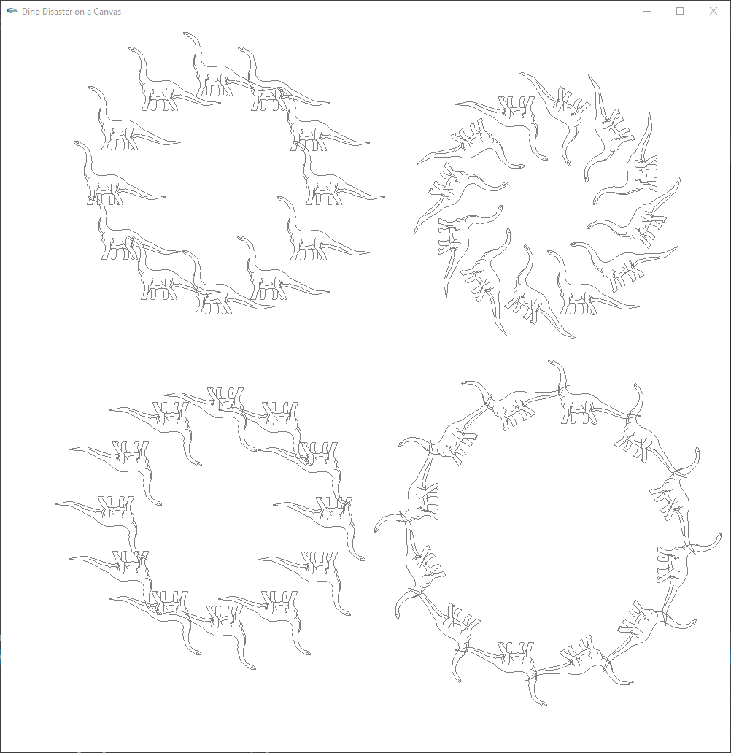
Part 1: The Dino in a viewport
Using a combination of the DrawPolyline function, and viewports is easy to create the circles of dinosaurs,
To find the location of each viewport we took the code to draw a circle,
Then for each set of dinosaurs we used an appropriate transformations such as scaling, and rotation.
To avoid needing to apply a translation for each dinosaur we moved the origin; this helped to avoid the dinosaur going out of view when rotating the dinosaur.

Slide 3
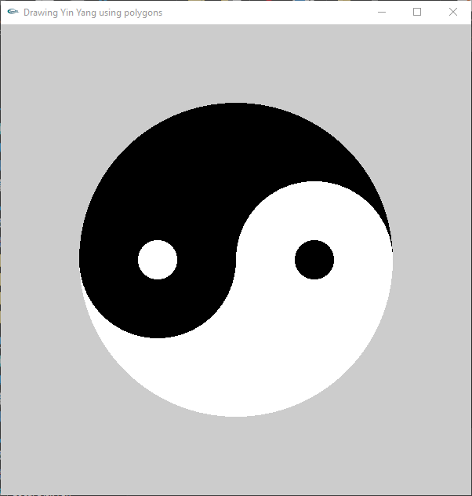
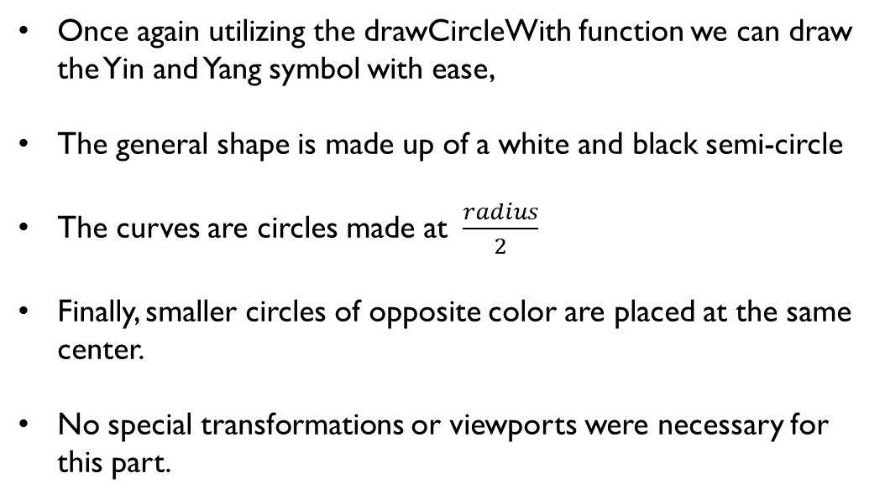
Part 2: Yin and Yang is the circle of balance
Once again utilizing the drawCircleWith function we can draw the Yin and Yang symbol with ease,
The general shape is made up of a white and black semi-circle
The curves are circles made at $\frac{radius}{2}$
Finally, smaller circles of opposite color are placed at the same center.
No special transformations or viewports were necessary for this part.

Slide 4
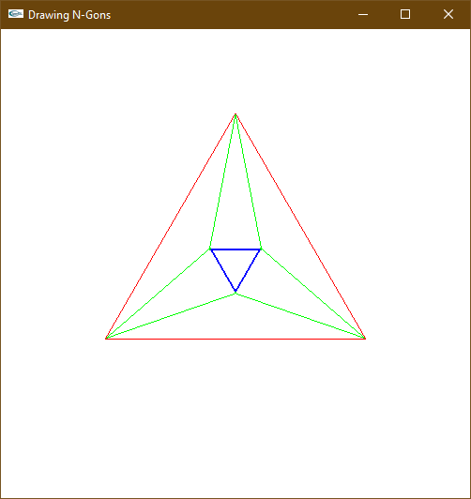
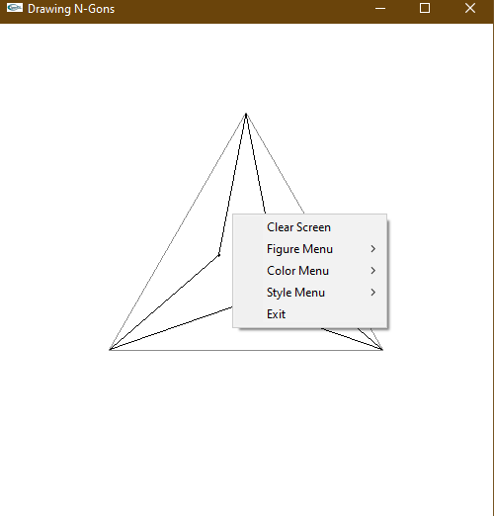
Part 3: N-gons with magic menu
To create the figure of n-gons with imbedded stars required the use of a series of n-gons.
The larger n-gons were simple and required some testing with rotation angles to align them correctly.
The star points are just triangles that have been rotated, translated, and scaled.
To hide the inner edges of the triangles and we have an inner n-gon which is just a smaller version of the outer n-gon.
For the menu we have a clear screen option, a figure submenu, a color submenu, and a style submenu.

Slide 5
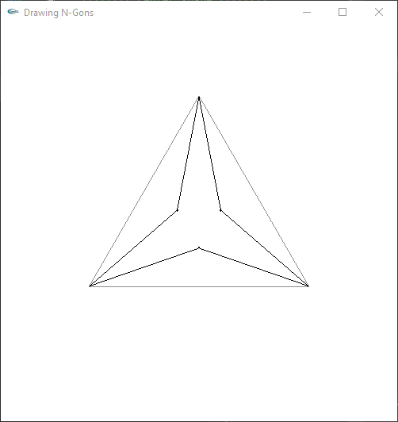
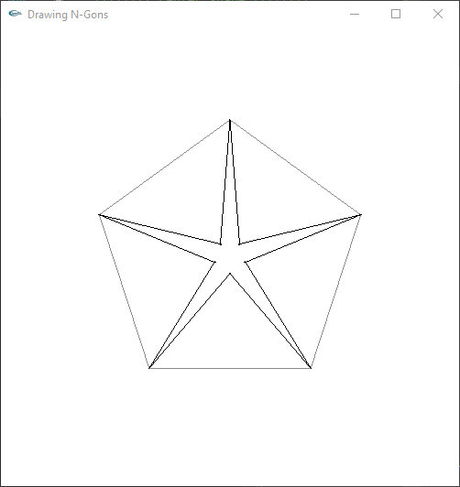
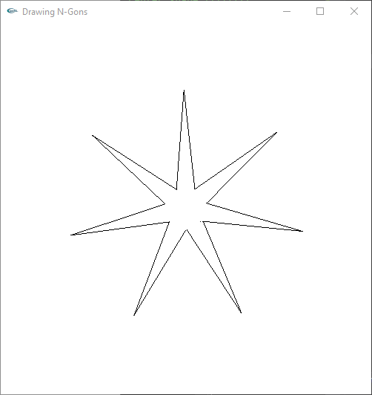
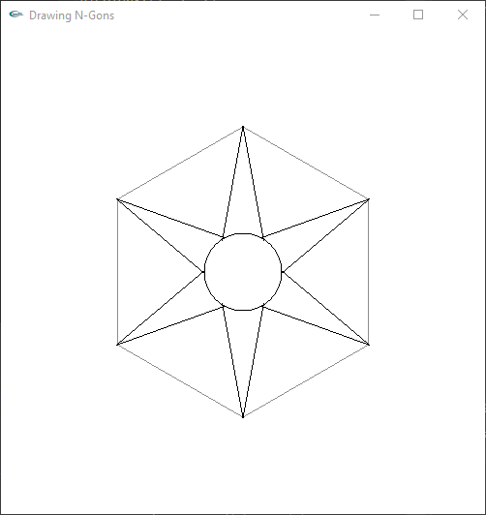
Part 3 Results
To remove the inner edges we set the central n-gon to white.
These are the required figures for the assignment.

Slide 6
conclusion
Viewports are a powerful tool to be able to draw in a defined region as if it were the window as a whole and allows for easy transformation of the entire figure rendered in the viewport.
Transformations allow for a large amount of modification to our figures and makes it easier to draw more complex figures without needing to do so manually.
Finally, a menu can have a large amount of functionality and extend the use of a program.

Slide 7

Questions?
Thank you for your attention.
If no questions, its onwards to the code review.

